Slide 1

Paypal Clone App
Presented by:
Eric goldove

Slide 2
Introduction
The Paypal Clone App is a LWC (Lightning Web Component) based solution.
This application is an online payment system that serves as an electronic alternative to traditional paper methods like checks and money orders.
The aim of developing this Paypal Clone App is to track all transactions of a customer, from bills and passbooks and monitor customer’s wallet balance and money spent.

Slide 3
System requirements
Paypal Clone app is a cloud based application and it only requires a browser and internet connection to run the application from the cloud.

Slide 4
Types of users
Admin
Support Team
Customer

Slide 5
User access
Customers can create wallet and card once, pay the bills before the due date, add pal and transfer money into them.
Support Team can create bills for customers and monitor all of the customer’s transaction and review if the transaction is flagged.
Admin can cancel the customer’s transaction and flag a transaction for further review.

Slide 6
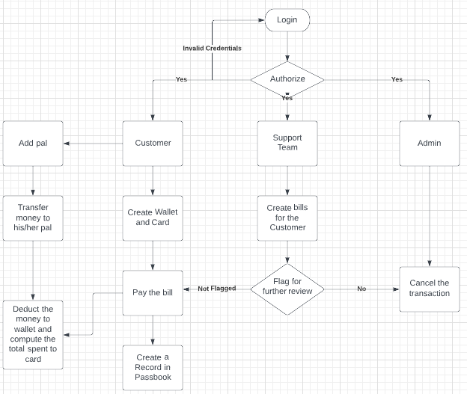

Slide 7
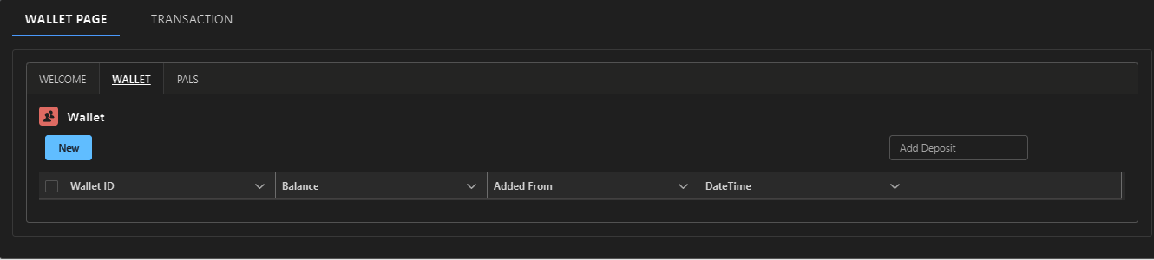
Wallet page

Slide 8
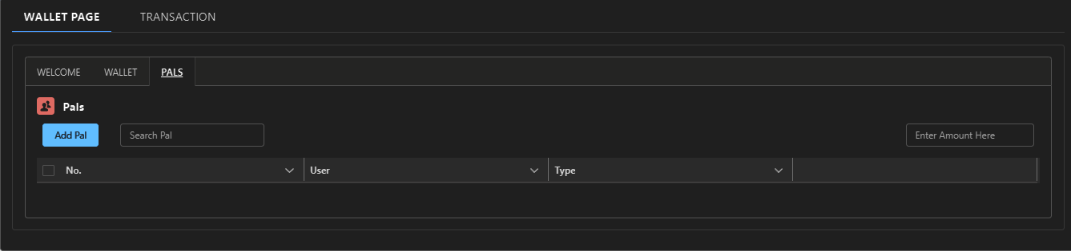
Pal page

Slide 9
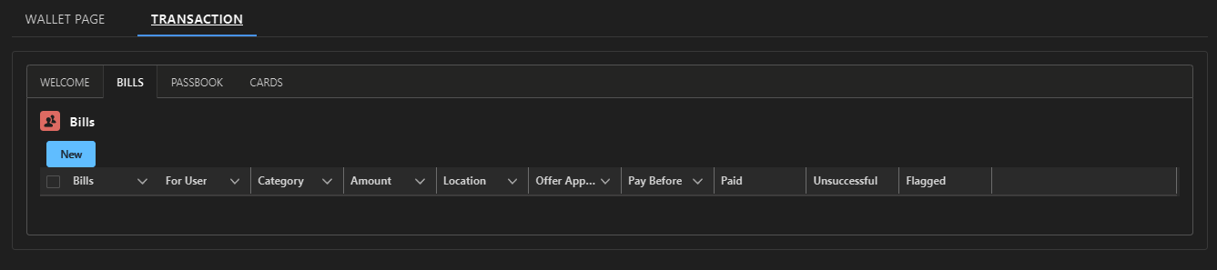
Bills page

Slide 10
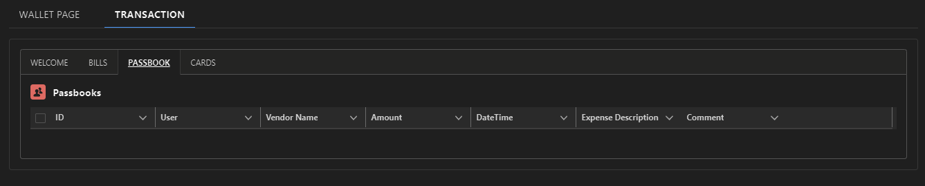
Passbook page

Slide 11
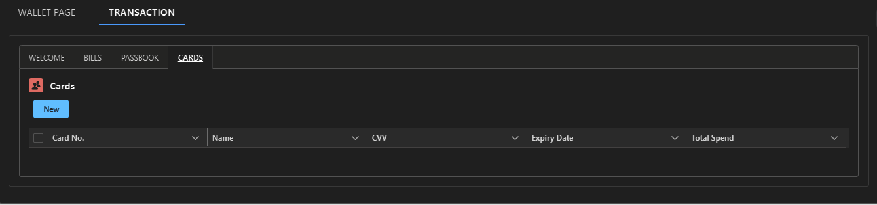
Card page

Slide 12
Validations & assumptions
All fields should be filled.
All date field can’t be date before the current date.
Discount should not exceed 80%.
Customer can’t enter cvv with negative value.
Customers can’t pay flagged transactions

Slide 13
“Thank you”

